Slide 1
Employee Data Analysis using Excel
STUDENT NAME: LAVANYA. C
REGISTER NO: 312200859
DEPARTMENT: B.com (General)
COLLEGE: Pachaiyappas college for women, kanchipuram.

Slide 2
PROJECT TITLE
Using Pivot Tables for Employee Turnover Analysis

Slide 3


AGENDA
Problem Statement
Project Overview
End Users
Our Solution and Proposition
Dataset Description
Modelling Approach
Results and Discussion
Conclusion
3/21/2024 Annual Review

Slide 4

PROBLEM STATEMENT
Our organization is experiencing fluctuating employee turnover rates across various departments. To address this issue effectively and make data-driven decisions to improve retention, we need to analyze turnover patterns comprehensively. The goal is to use pivot tables to identify key trends, correlations, and factors contributing to employee turnover.

Slide 5

PROJECT OVERVIEW
Pivot Tables are a powerful tool in Microsoft Excel that allow you to quickly summarize, analyze, and compare large amounts of data. In HR, pivot tables can be used to analyze HR data and make more informed decisions.Pivot Tables are a data analysis tool inMicrosoft Excel that allow for quicksummarization, analysis, and comparisonof large amounts of data. They work byselecting data to analyze, dragging it into apivot table area, and defining the rows,columns, and values to be included. Theresulting pivot table provides a clear andconcise presentation of the data, enablingimproved data visualization, analysis, anddecision-making.Pivot tables alsoautomate the data analysis process, savingtime and effort. They are a valuable tool forHR professionals to gain a betterunderstanding of key HR metrics and makemore informed decisions.
.

Slide 6

WHO ARE THE END USERS?
Human Resources (HR) Managers:
Department Managers/Supervisors:
Senior Management/Executives:
Employees:

Slide 7

OUR SOLUTION AND ITS VALUE PROPOSITION
1. Data Summarization: Pivot tables allow you to condense large volumes of employee data into meaningful summaries. This helps in quickly understanding turnover rates, trends, and patterns without manually sifting through raw data.
2. Trend Analysis: You can analyze turnover trends over time by setting up rows and columns for different time periods. This helps in identifying seasonal patterns or periods of high turnover.
3. Efficiency and Speed: Pivot tables streamline the process of data analysis, reducing the time and effort required to generate insights. This efficiency allows HR professionals to quickly address turnover issues and make data-driven decisions.
4. Actionable Insights: By providing a clear view of turnover metrics and contributing factors, pivot tables enable organizations.

Slide 8
Dataset Description
1.Employee ID: Numeric or alphanumeric. A unique identifier for each employee, used to track individual records. 2.Employee Name: Full name of the employee (optional for analysis but useful for identifying records).
3.Department: The department in which the employee worked, such as Sales, Marketing, HR, etc.
4.Job Title: The employee’s job title or role within the organization.
5.Hire Date: The date when the employee was hired.
6.Termination Date: The date when the employee left the organization. For active employees, this field might be blank or marked as “Current.”
7.Reason for Leaving: The reason the employee left, such as voluntary resignation, retirement, layoff, or termination.
8.Employment Status: Current status of the employee (e.g., Active, Resigned, Terminated). Employee’s performance rating or score if applicable, which can be used to analyze turnover in relation to performance.
9.Exit Interview Score: Scores or feedback from exit interviews, if available, to gain insights into why employees leave.
10.Gender: Gender of the employee, useful for analyzing turnover by demographic factors.
11.Age: Age of the employee, which can be used to study turnover patterns by age group.
12.Location: The geographical location of the employee’s workplace, useful for analyzing turnover by location

Slide 9

IN OUR SOLUTION
1.Create a PivotTable: Select the cells you want to use, then click Insert > PivotTable.
2.Add a field: Select the field name checkbox in the PivotTables Fields pane.
3.Refresh a PivotTable: If you add new data to the source, you need to refresh any PivotTables that use that data. 4.Calculate values: Click the PivotTable, then click Fields, Items, & Sets > Calculated Field in the Calculations group on the Analyze tab.
5.Create a calculated item: Click Fields, Items & Sets > Calculated Item on the PivotTable analyze tab, then enter a name in the Name box.
3/21/2024 Annual Review
9

Slide 10
MODELLING
1. Prepare Your Data: Ensure your data is organized in a table format with columns such as:
Employee ID
Department
Job Title
Hire Date
Termination Date
Reason for Leaving
Age
Gender
2. Create a Pivot Table:
Select Your Data: Highlight the range of your dataset.
Insert Pivot Table: Go to the "Insert" tab and select "Pivot Table". Choose to place the Pivot Table in a new worksheet or the existing one.
10

Slide 11
MODELLING
3. Configure Your Pivot Table: To analyze employee turnover, you might set up your pivot table with the following steps:
Rows: Drag fields such as "Department" or "Job Title" to the Rows area to see turnover by different segments.
Columns: Drag "Year" or "Month" (if you have a date field) to the Columns area to analyze turnover over time.
4. Analyze the Data: To calculate the turnover rate, you might need to add a calculated field or use a separate column to show the percentage of employees leaving relative to the total number of employees.
5. Refine and Visualiz: Apply conditional formatting to highlight high turnover rates or other significant insights.
6. Interpret Results:
Identify Key Drivers: Use the insights from your pivot table to understand which departments, job titles, or periods have higher turnover rates.
Actionable Insights: Develop strategies to address high turnover areas, such as improving employee satisfaction in departments with high turnover rates or adjusting recruitment practices for roles with higher attrition.
11

Slide 12
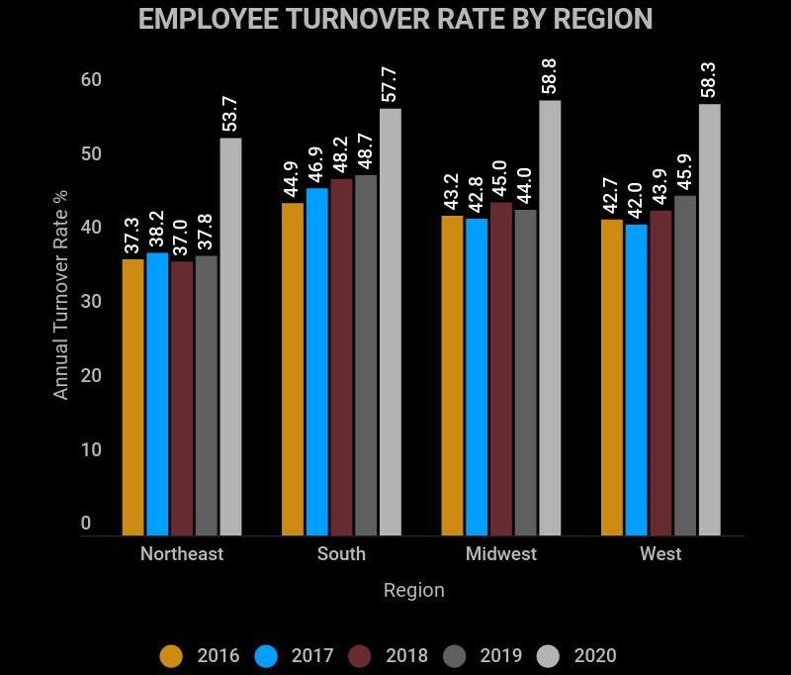
RESULTS
12

Slide 13
conclusion
Pivot tables are a valuable tool for HR professionals that can help improve the visibility, efficiency, and effectiveness of HR data and decision-making. By applying pivot tables to HR data, HR professionals can gain a better understanding of key HR metrics, identify areas for improvement, and make more informed decisions. Pivot tables can automatically summarize, group, sort, filter, and visualize data. This can help you extract insights from complex datasets. Pivot tables can help you make more informed decisions by helping you quickly synthesize and analyze data.

